Slide 1

09. Seerat of
Holy Prophet (S.A.W.W) II
(HIJRAH TO MADINAH)
Course Instructor
Islamic Studies:
Mufti Omer Rafique

Slide 2
LIFE OF HOLY PROPHET(S.A.W) AT MADINAH
HIJRAH TO MADINAH:
The annual Hajj of the kaba brought to Makkah many people from all part of Arabia. Holy prophet (S.A.W) tried to convey his message to some inhabitants of Yasrab (Madinah). At that time His age was 51 years and the people of yasrab, they were total 12 in no, they accepted Islam, taken an oath, request for a teacher who preach Islam in Yasrab. Holy Prophet (SAW) sent Hazrat Musab bin Umair, who led a contigent of 73 people, they also accepted Islam taken an oath and invited Holy Prophet (SAW) for migration to Yasrab(Madinah). These two occasions of oath known as first and second pledges of Al-Aqbah.

Slide 3
Holy prophet (SAW) gave permission to his companions to migrate to Madinah. Secretly and in small groups a great part of the Muslims migrated to Madinah. Holy Prophet (SAW) was waiting for permission by Allah to migrate to Madinah himself. After getting permission Holy Prophet (SAW) migrated to Madinah and his age was 53 years. After migration yasrab became Madinah.

Slide 4
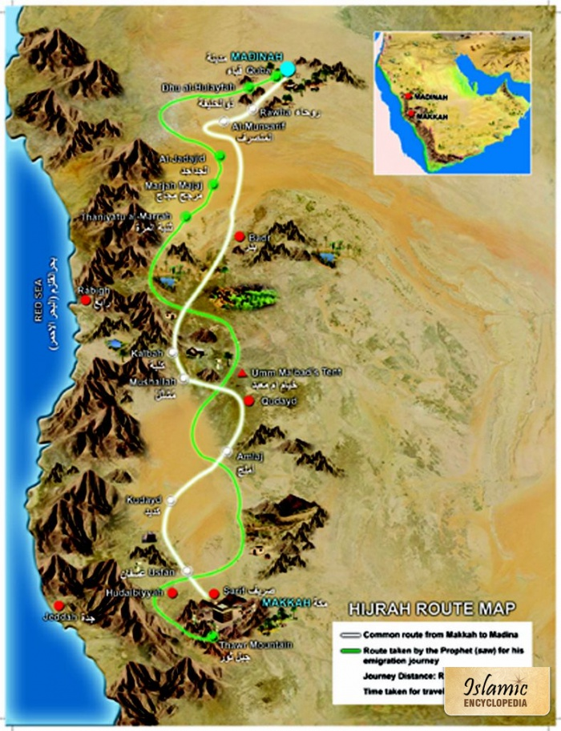

Slide 5
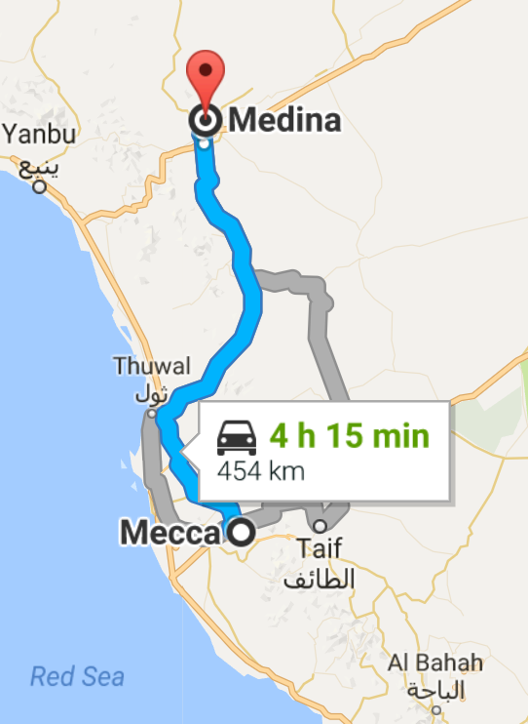

Slide 6
BROTHERHOOD:
After migration, the first job completed by Holy Prophet (SAW) was the creation of brotherhood among Muhajareen and Ansar. They treatd with eachother like actual brothers and this event is known as Muwakhat e Madinah in the history of Islam.
CHARTER OF MADINAH:
In Madina there were three Jews tribes, Banu Nazir , Banu Quraizah and Banu Qanqua were living . Two christian tribes Banu Aous and Banu Khazraj were also living. The Jews tribes were creating fighting between these two christian tribes for their own safety. Holy Prophet (SAW) , after migration dictated a chartered b/w Muslims and Jews with the following terms:

Slide 7
The system of blood money would continue.
The Jews will have full religious freedom.
Jews and Muslims maintain friendly relations.
No party will give refuge to the Quraish of Makkah.
In every matter, both will help each other.
If Madinah is attacked both parties will participate for defence.For peace both parties will participate.
The oppressed one would be provided full help.
The final decesion would be with Holy Prophet (SAW).

Slide 8
BATTLE OF BADR:
Battle of Badr was a great victory of Muslims in history of Islam.
A final decision between right and wrong.
Battle was fought in 2nd Hijra at the place of Badr.
Allah Almighty helped the muslims with angels.
Quran says
“Your Lord will help you with five thousand angels”
Holy Prophet (S.A.W) got help from Allah in the shape of prostration. A long prostration was done by Holy Prophet (S.A.W).

Slide 9
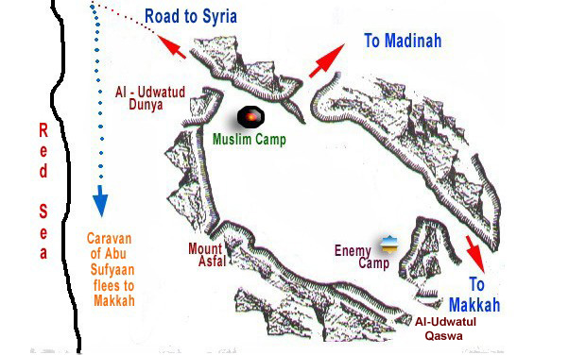

Slide 10
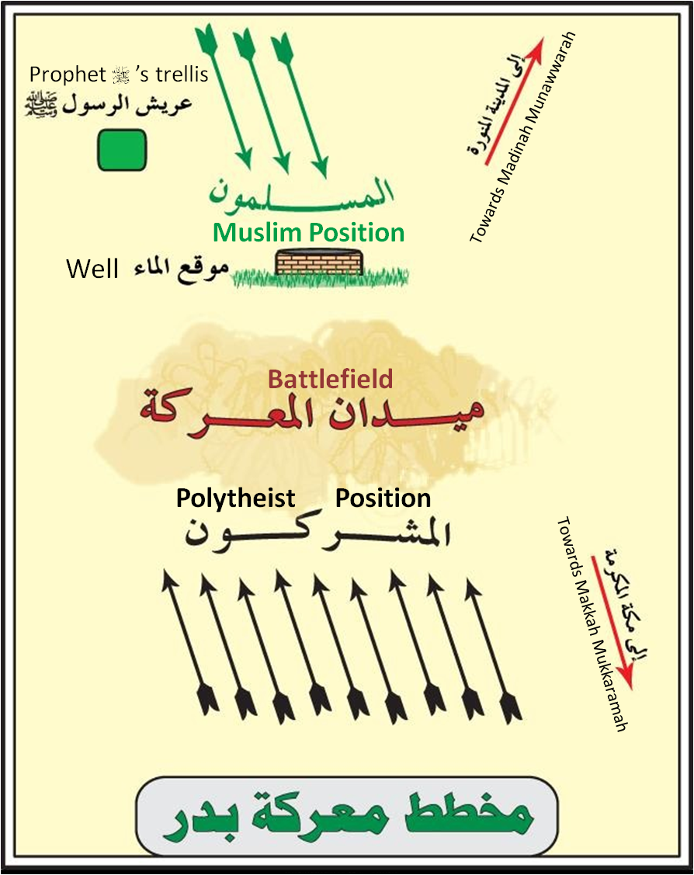

Slide 11
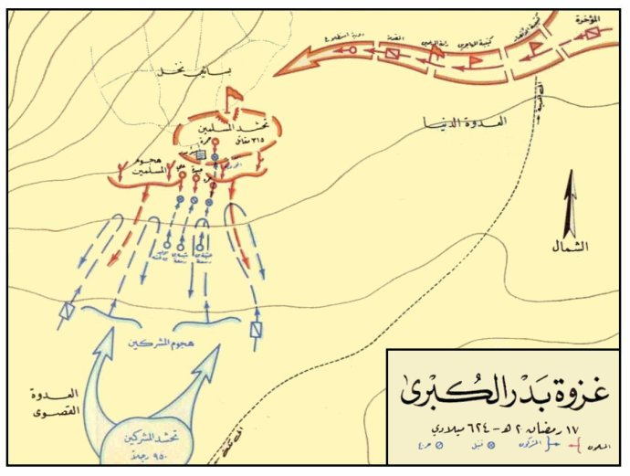

Slide 12
It was unacceptable for the non Muslims of Makkah that the total number of Muslims was increasing day to day, Therefore, they were searching a reason to attack on Madinah to finish the Islam and Muslims.
In 2nd Hijra a Carvan was coming back to Makkah in the leadership of Abu-sufyan from Syria after completing business at Syria
A false statement was announced by Abu-Jahal in Makkah that the Carvan had been attacked and many people had been killed by the Muslims of the Madinah.
After hearing this news Non- Muslims of makkah started preparations for war with Muslims
Therefore one thousand soldiers of Non-Muslims marched towards Madinah in the leadership of Abu-Jahal. The biggest leaders of Quraish participated in this Battle.

Slide 13
These one thousand people were loaded with full weapons on the other side the total number of Muslims were only 313 and they were loaded only with few weapons.
Holy Prophet called all his companions (Sahaba Ikram) and prepared for war.
At the place of Badr this war was started, all big leaders of non-Muslims including Abu-Jahl, Utba, Sheba and Waleed were killed.
Non-Muslims of Makkah were defeated very badly.
Their seventy soldiers were killed and seventy were arrested.
Only 22 Muslims got martyred.
The Muslims won this Battle with the help of Allah Almighty.

Slide 14


